Slide 1
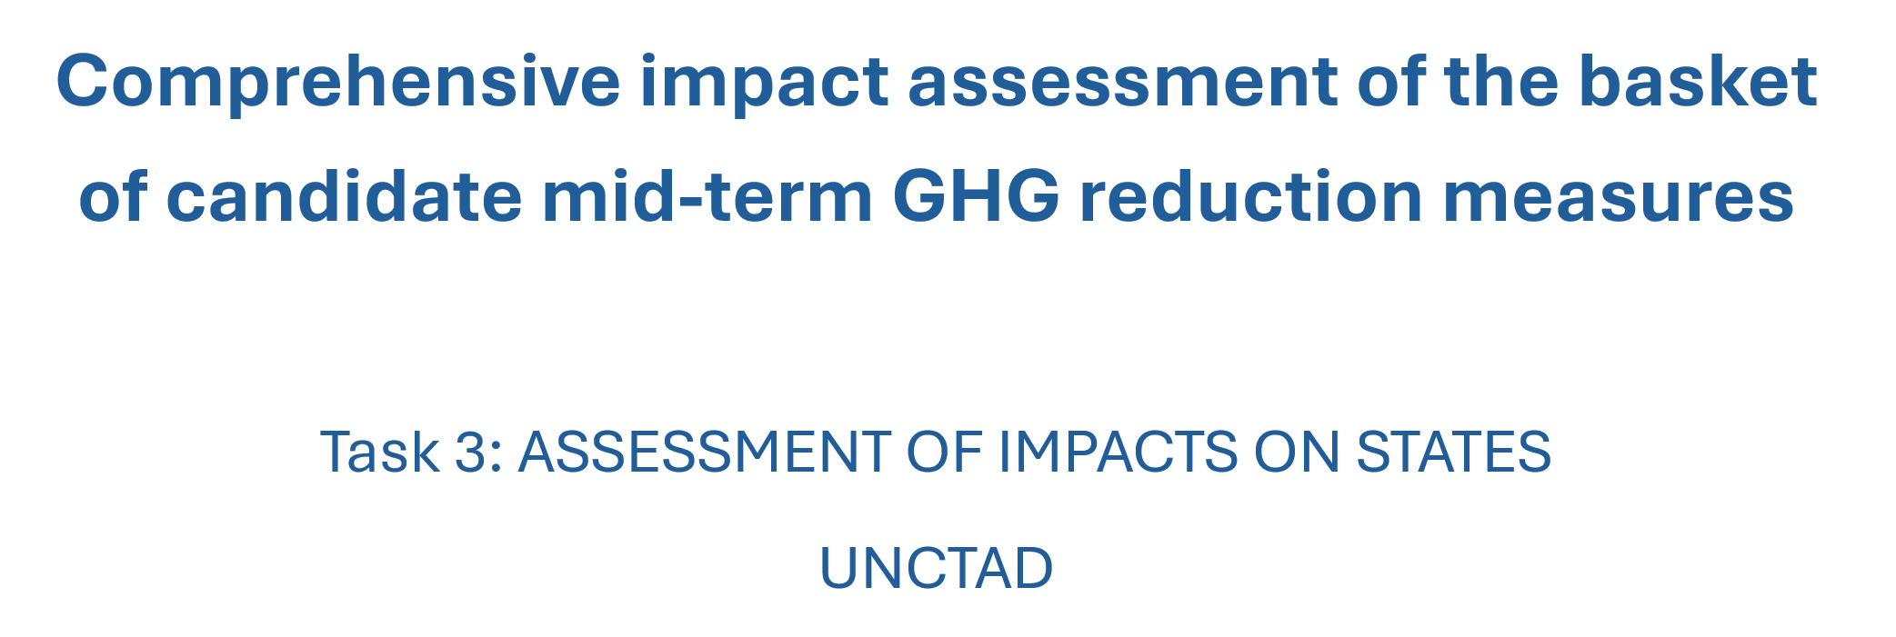

5th GHG Expert Workshop
London, 4-5 September 2024

Slide 2
Our methodology
Maritime economics
Economic measures

Slide 3
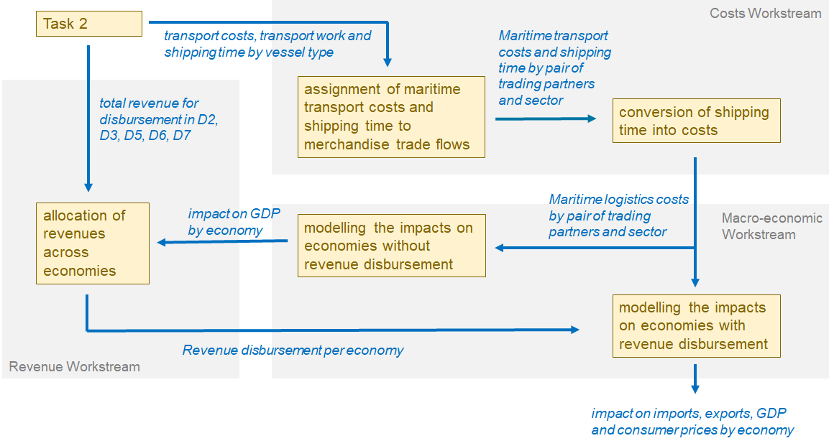
Main modelling steps and data flows

Slide 4
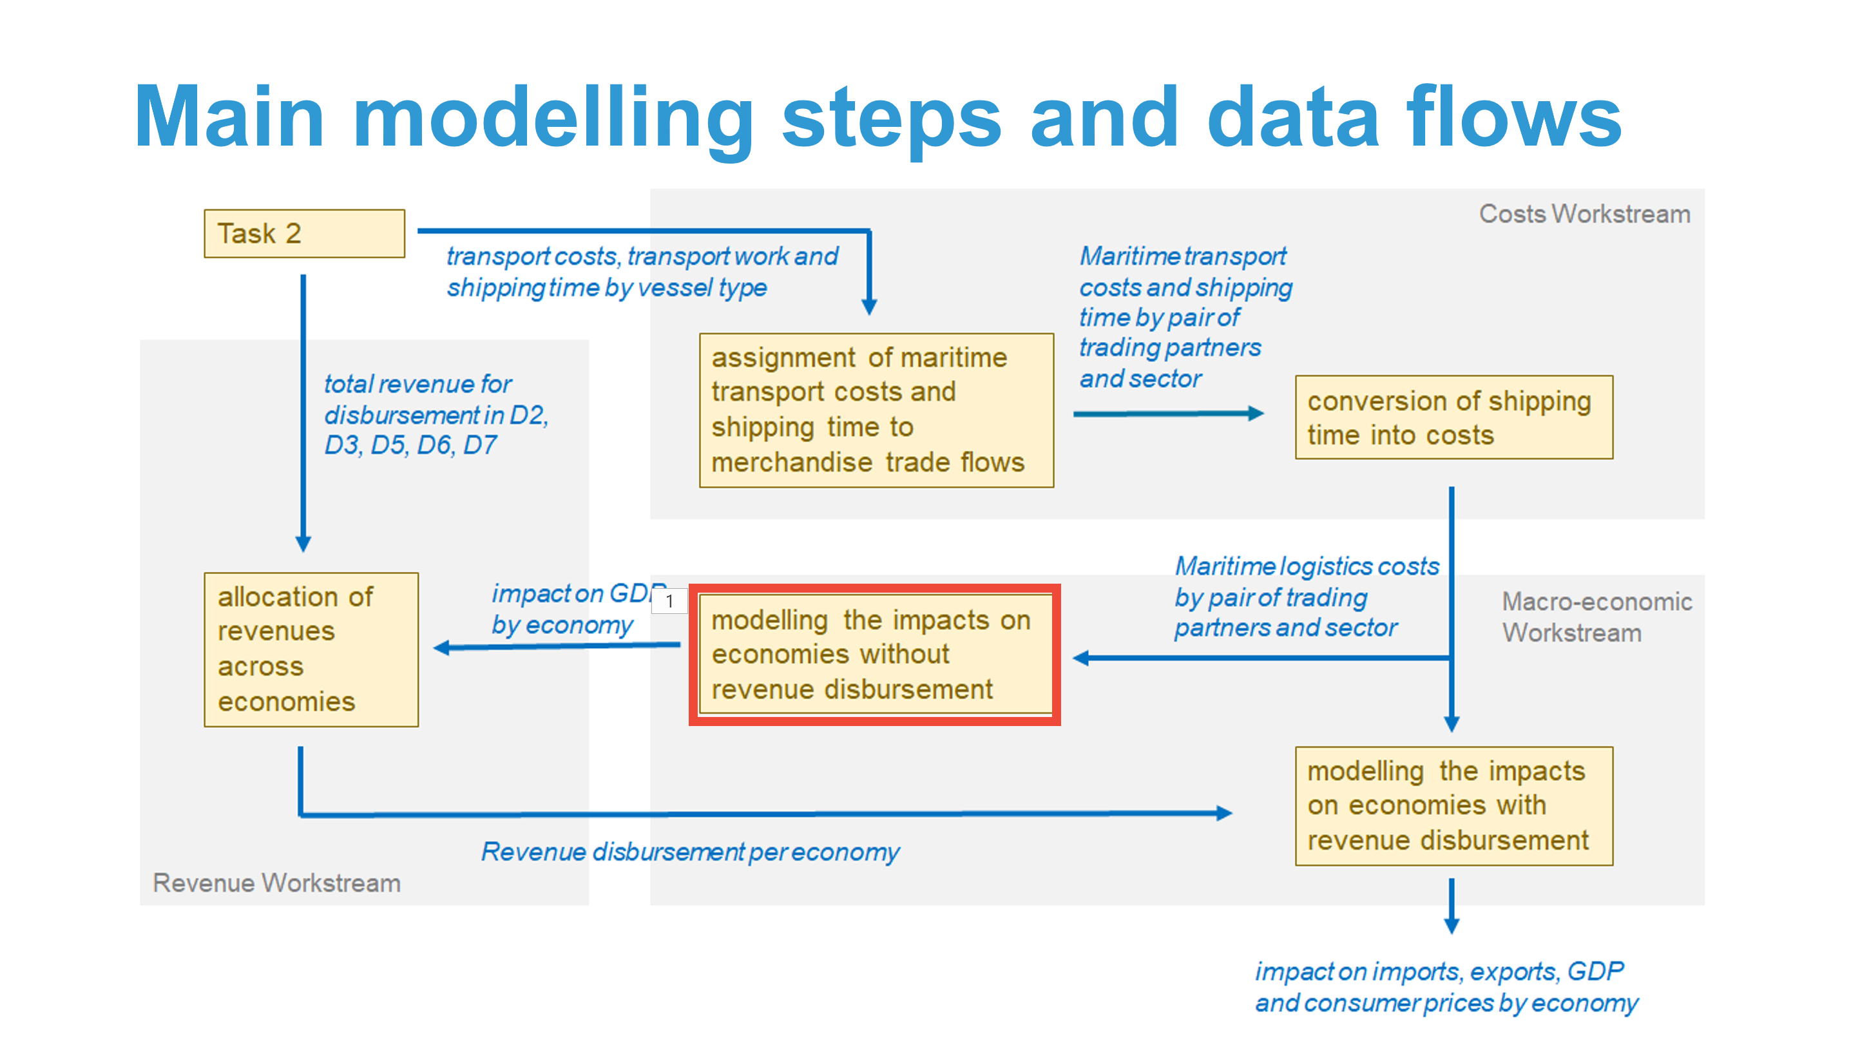
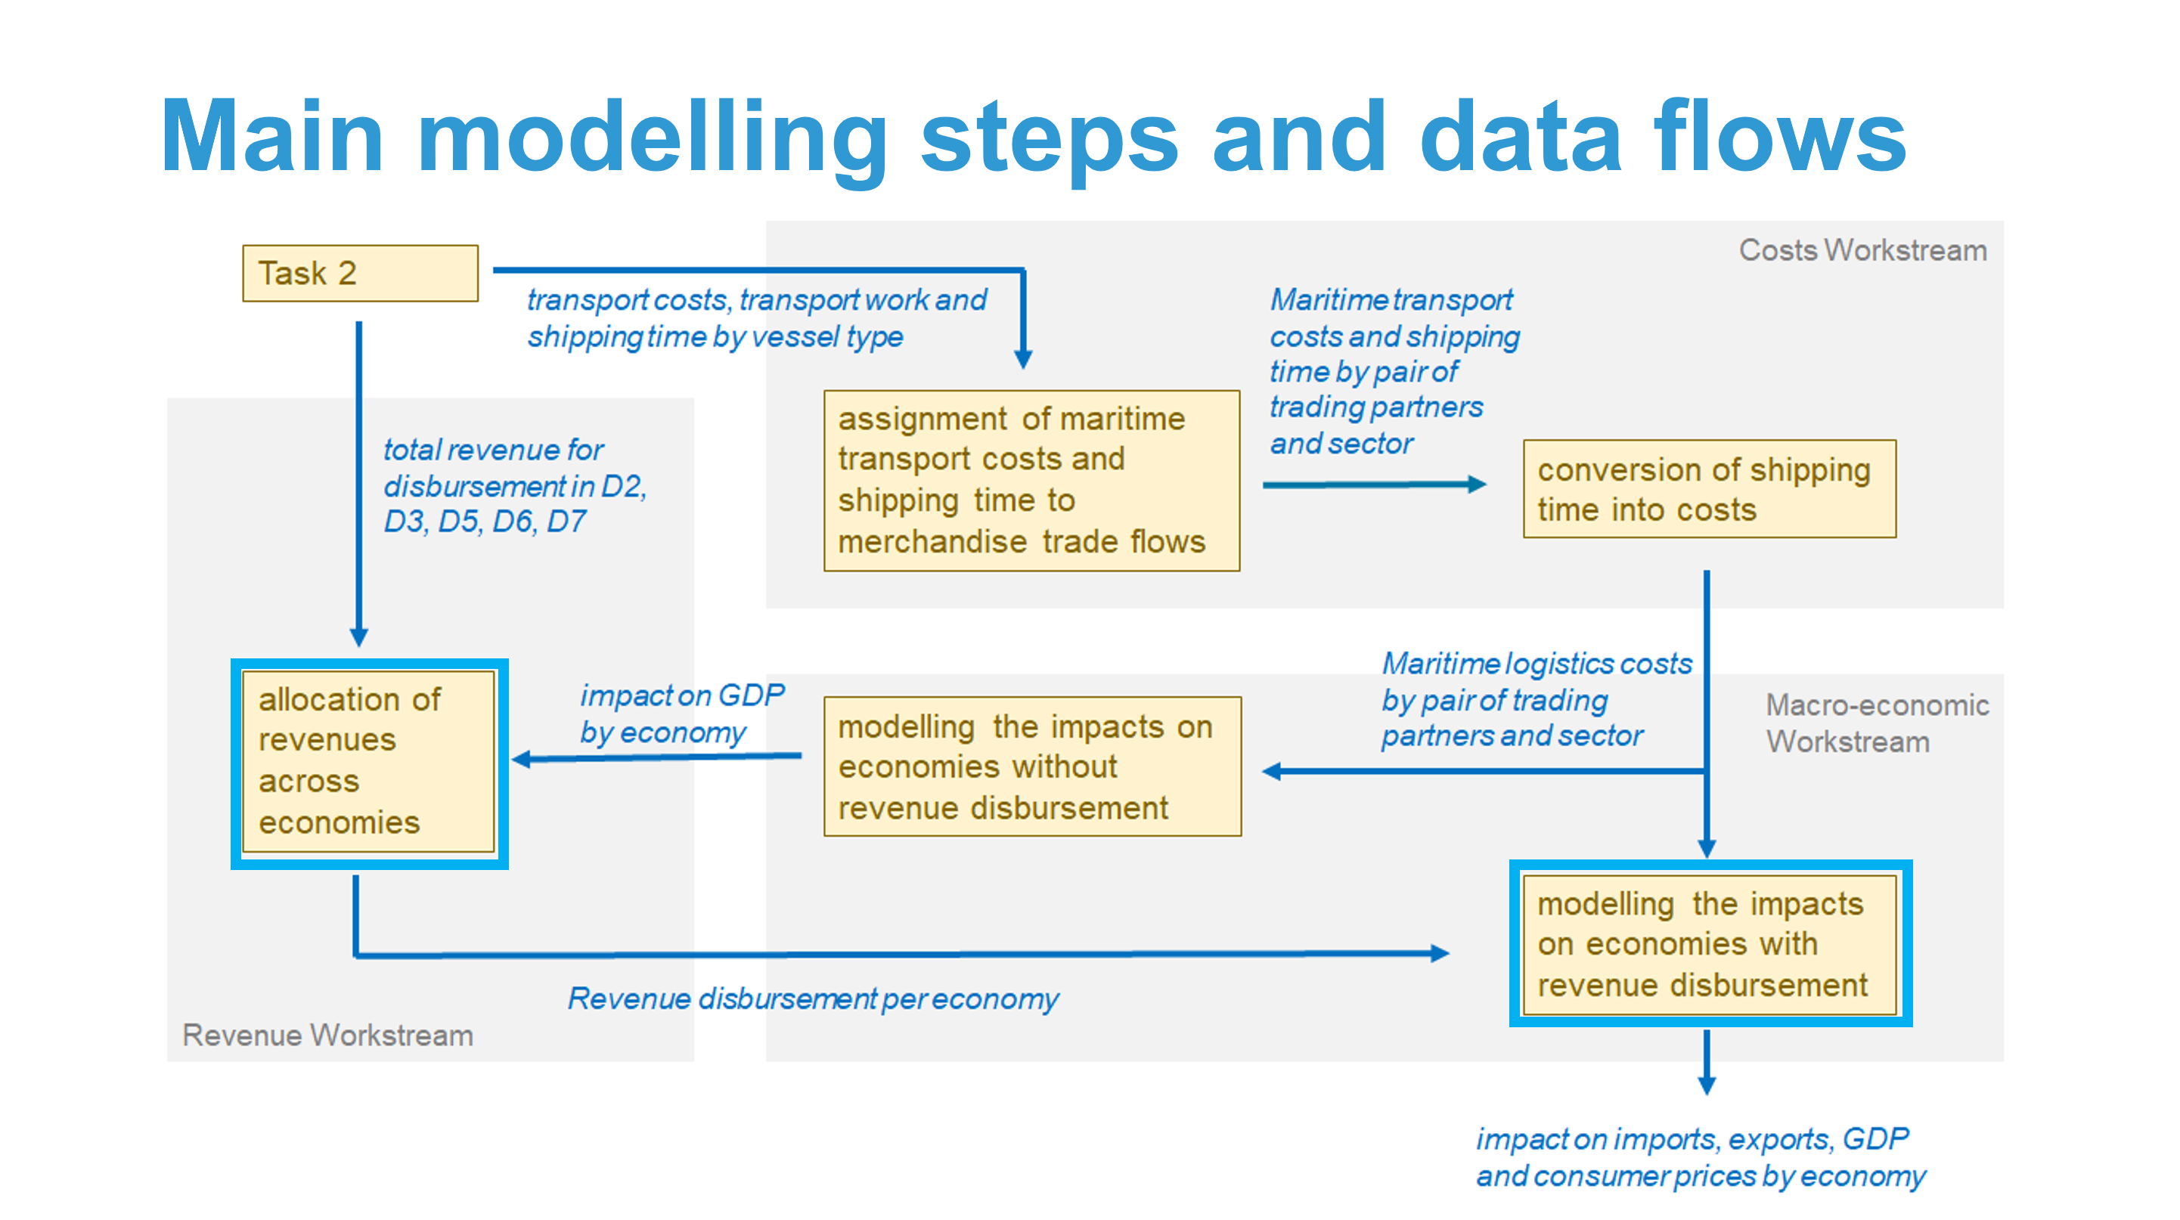
Revenue disbursement schemes analyzed
Level-1 criterion | Level-2 criteria
No disbursement | -
All countries | Percentage change in GDP, population size
Developing countries, including SIDS and LDCs
SIDS and LDCs

Slide 5
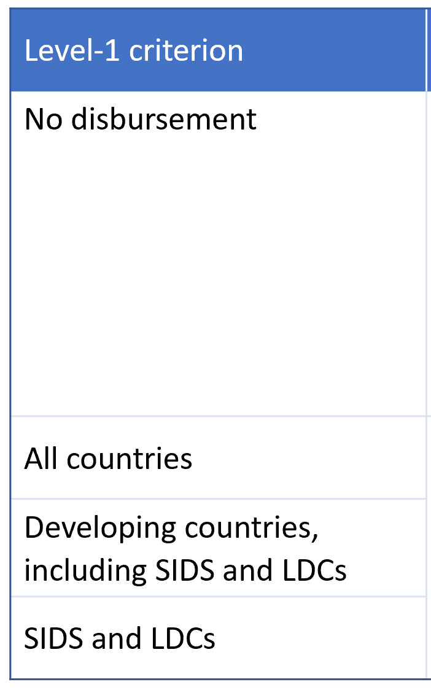
10 Scenarios analyzed, with 22 simulations
Scenario number | Emis- sion trajec- tory | Sea- borne trade growth | Policy code | GFI scope | GFI flexibility |  | Levy |  | Feebate (% of gap) | Revenue disburse- ment modelling
 |  |  |  |  | RU (% of price) | SU (% of price) | Levy ($/tCO₂eq) | Reward (% of gap)
21 | Base | Low | X.1 | TtW | No flexibility |  | No levy |  | No feebate | -
22 | Base | Low | Y.1 | WtW | No flexibility |  | No levy |  | No feebate | -
23 | Base | Low | X.4 | TtW | 120% | 80% | No levy |  | No feebate | -
24 | Base | Low | Y.4 | WtW | 120% | 80% | No levy |  | No feebate | -
26 | Base | Low | Y.2 | WtW | No flexibility |  | 150-300 | 90-65% to 2040 | No feebate | yes
31 | Base | Low | X.5 | TtW | 120% | 80% | 30-120 | 105% to 2040 | No feebate | yes
32 | Base | Low | Y.5 | WtW | 120% | 80% | 30-120 | 105% to 2040 | No feebate | yes
36 | Base | Low | Y.6 | WtW | 120% | 80% | No levy |  | 105% to 2040 | -
43 | Strive | Low | X.4 | TtW | 120% | 80% | No levy |  | No feebate | -
46 | Strive | Low | Y.2 | WtW | No flexibility |  | 150-300 | 90-65% | No feebate | yes

Slide 6
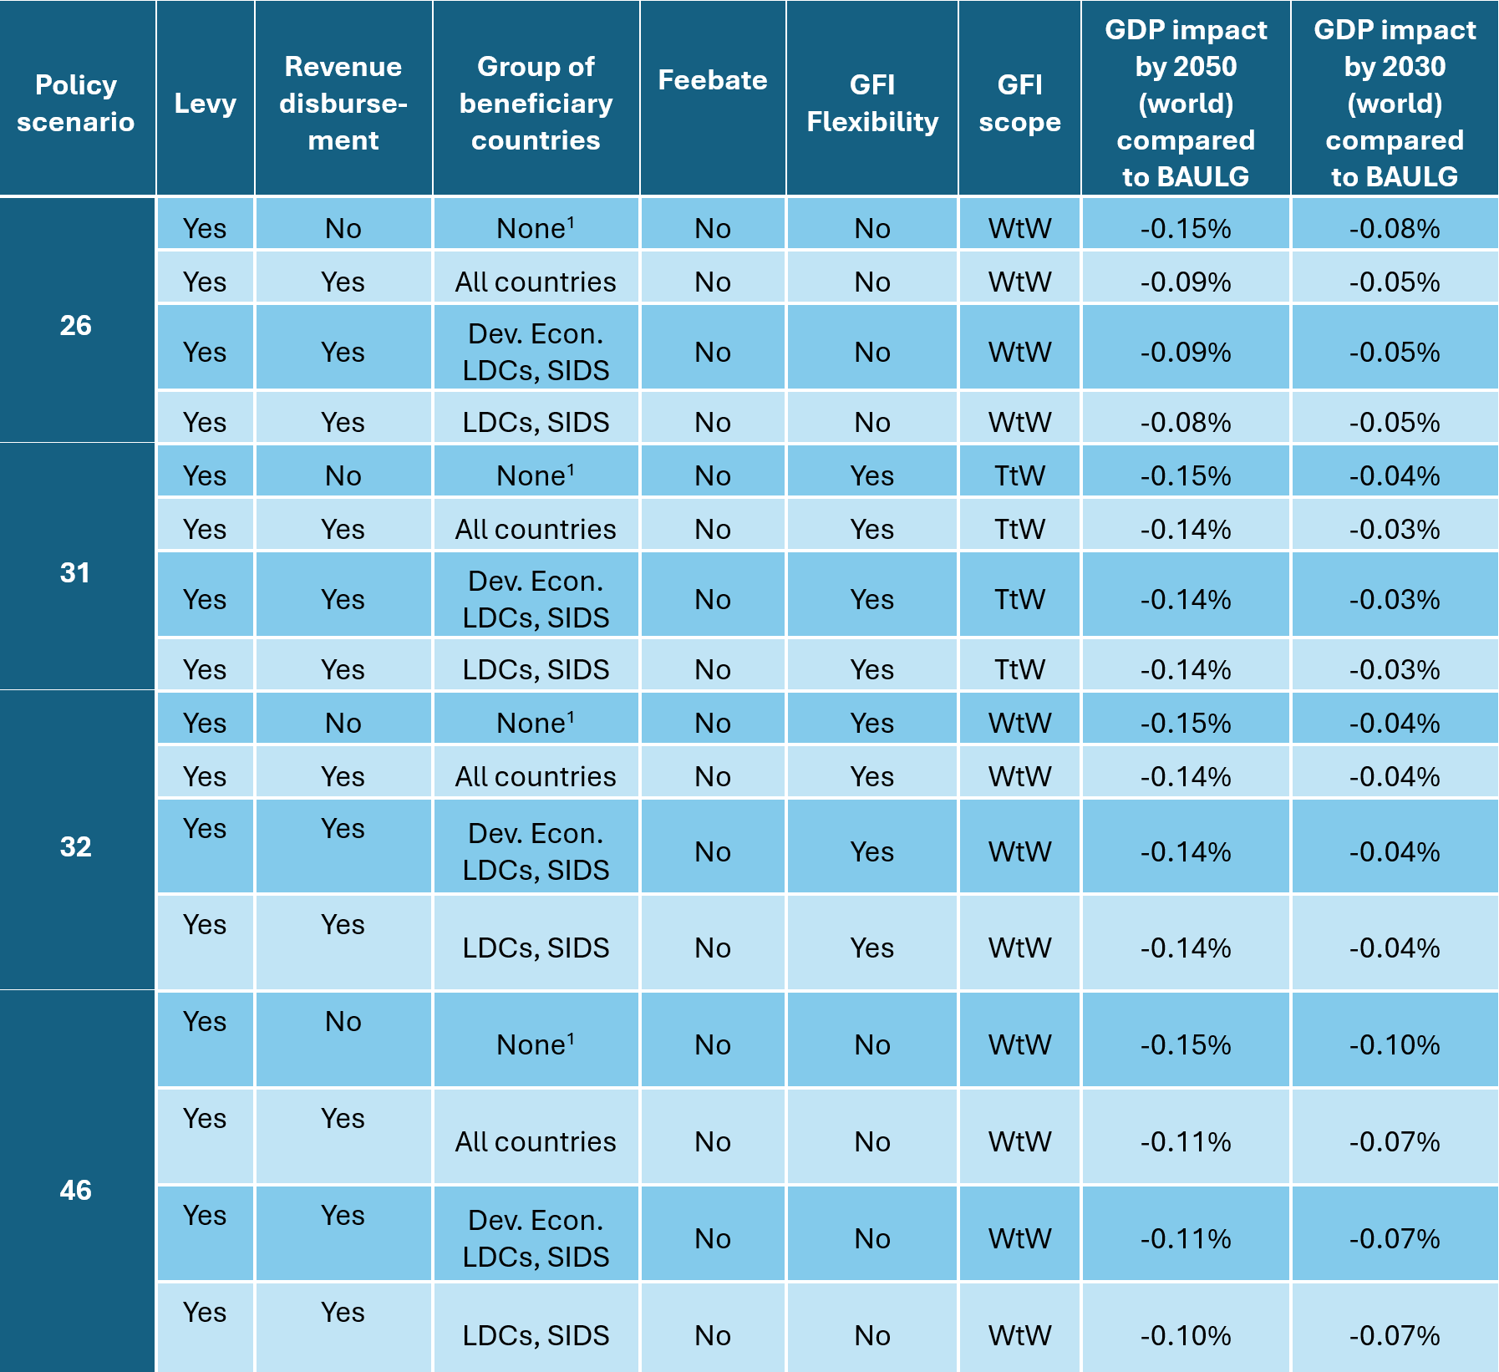
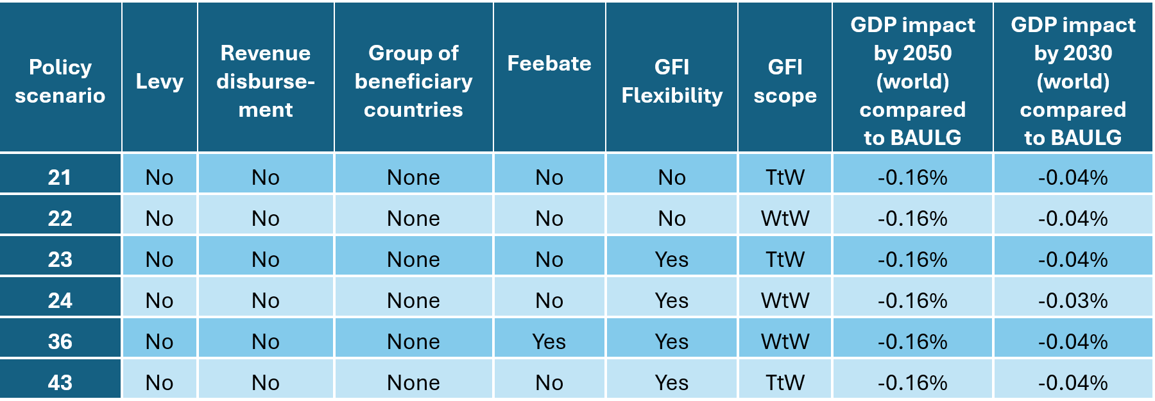
Summary table of key GDP Impacts
(world aggregates)

Slide 7
Our methodology
Maritime economics
Economic measures

Slide 8
Price
Demand
Supply
Volume

Slide 9
Freight
Rate
Demand
Supply
Volume

Slide 10
Freight
Rate
Demand
Supply
Volume

Slide 11
Freight
Rate
Demand
Supply
Volume

Slide 12
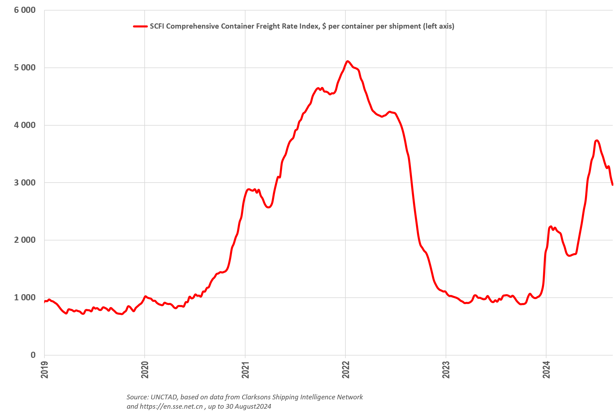
Red Sea:
Supply crunch as ships spend more time
(+9%) at sea
Covid:
Supply crunch as ships
spent more time
(+20%) in ports

Slide 13
Our methodology
Maritime economics
Economic measures

Slide 17
Our methodology
Maritime economics
Economic measures

Slide 18
Main modelling steps and data flows

